Slide 1
The Crucible
Arthur Miller

Slide 3
Arthur Miller: A Life
Born on October 17, 1915
Attended the University of Michigan from 1934-1938
Graduated with a degree in journalism
Wrote and produced five plays during college career
Married three times
Two daughters, one son

Slide 4
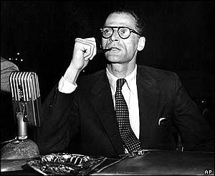

Slide 5
Miller and HUAC
Investigated for possible associations with the Communist party from 1953 to 1955
In 1956, he was called to testify before the House Committee on Un-American Activities (HUAC).
Only attended meetings looking to advocate social justice and equality
When brought before the committee, he refused to name any other attendees.

Slide 6
Miller and HUAC (cont.)
Found guilty of contempt
Later released

Slide 7
The Red Scare
A time of paranoia and hysteria over communism
Many government officials were involved or accused.
Many writers, actors, and directors lost their jobs
Many named names to save their own careers

Slide 8
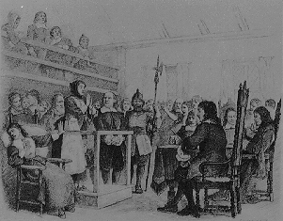
Salem, 1692

Slide 9
The Salem Witch Trials
In 1692, twenty were executed; 150 were jailed.
The Puritan culture attributed its hardships to the Devil.
Several girls in the town began to have seizures and lapses of unconsciousness after seeking Tituba, a slave from Barbados, for fortunetelling.

Slide 10
The Salem Witch Trials (cont.)
Tituba and two elderly women were accused at first; by the end, many of the community’s most prominent citizens were accused.
Overall nineteen were hanged, four accused died in prison, and one was pressed to death
In 1706, Ann Putnam signs a letter of apology.

Slide 11
Salem Witch Trials (cont.)
Samuel Sewell was the only judge to apologize for actions.

Slide 12
Possible Causes
Hallucinations from spoiled food
Boredom
Strict society
Social cleansing?
Land dispute

Slide 13
Connections
Miller wrote The Crucible as a metaphor for the Red Scare in the 1950’s.
He felt there was a “witch hunt” within the government and beyond
Like the witch trials, it was easier to admit guilt than maintain innocence.
The play is widely performed when social unrest is present in a culture.

Slide 14
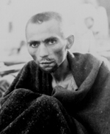
20th Century Witch Hunts
The Holocaust

Slide 15
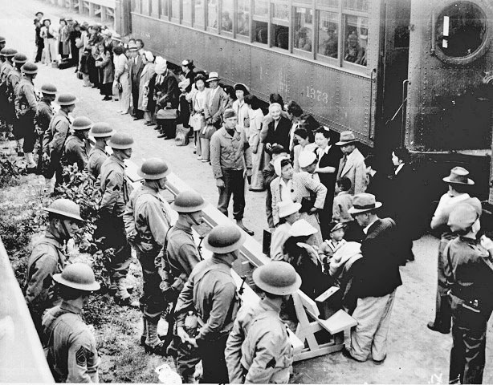
20th Century Witch Hunts
Japanese-American Internment Camps

Slide 16
20th Century Witch Hunts: Racial Profiling
African Americans
Native Americans
Arab/Middle-Eastern decent

Slide 17
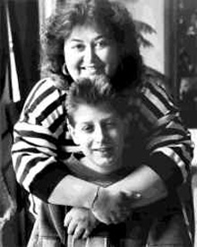
20th Century Witch Hunts: Stereotypes
Homosexuality
AIDS

Slide 18
Closing Thoughts
Be aware of false accusations
Rumors do harm
Integrity is key
Not all things are as they seem

